Slide 1

Predicting Loan Defaults Using ML Model
`
Group AS²RK
Team members:
Shrouq Alharbi
Sarah Alzahrani
Asmaa Alzahrani
Amani Almutairi
Rawan Alshehri
Khalid Alsuahimi

Slide 2

Table of Contents
01
Background
02
Problem Statement
03
Business Solution
04
Business Values
05
Implementation
06
Conclusion

Slide 3
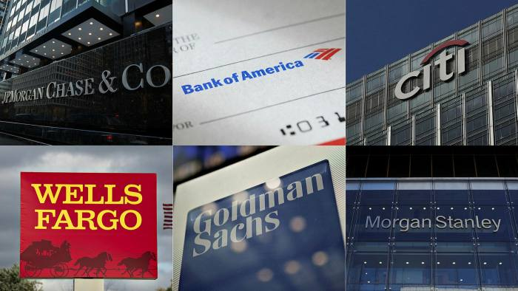




Background
Notes:
One of the most important products offered by banks and lending institutions is a loan. All banks are seeking to come up with effective business strategies for persuading customers to apply for loans. They also seek to accept as many loan applications as possible in the hopes that everyone would be able to repay the loan at a fair interest rate. This is the most likely scenario in an ideal world. However, because we do not live in a perfect world, some customers may behave negatively once their applications are approved, and they may not be able to return the loan as soon as we would want.
As a result, the problem statement is the unfavourable behaviour when a client fails to pay a loan, resulting in business losses.

Slide 4


Problem Statement
The unfavourable behaviour when a client fails to pay a loan, resulting in business losses.

Slide 5

Business Solution
Building a machine learning model to comprehend the previous customers' profiles and predict future loan default risk.
Notes:
Business solution
The aim of the project is to build a machine learning model to predict and comprehend the previous customers' profiles in order to mitigate future loan default risk. We will use a dataset that includes data about credit applicants to develop and train a model that will assist in determining if the applicant’s profile is suitable to enter the lending process; otherwise, it will be rejected.

Slide 6


Business Values
Assist in identifying high-risk consumers by predicting the factors impacting payback.
Enables businesses to strike a balance between risk and profit.
Identify the behavioral patterns that contribute to future loan default.
Notes:
Business value
To identify the features and behavioral patterns that contribute to future debt repayment problems.
Because loans are risky but also a valuable commodity for the business, utilizing a machine learning model can assist in identifying high-risk consumers by predicting the factors impacting payback. As a result, it helps lenders reduce their losses.
Predicting high-risk consumers enables businesses to strike a balance between risk and profit. Additionally, it contributes to profit growth by boosting client access to loans.

Slide 7


Implementation

Slide 8
Project Structure
Compare between models and Select the right fit
Selection and Get data
Exploratory Data Analysis (EDA)
Building the predictive machine learning model
Visualization
Data Wrangling: Cleansing and Feature Selection
Goal 6
Goal 1
Goal 2
Goal 5
Goal 3
Goal 4

Slide 9
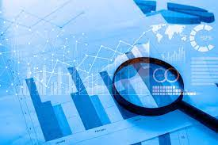
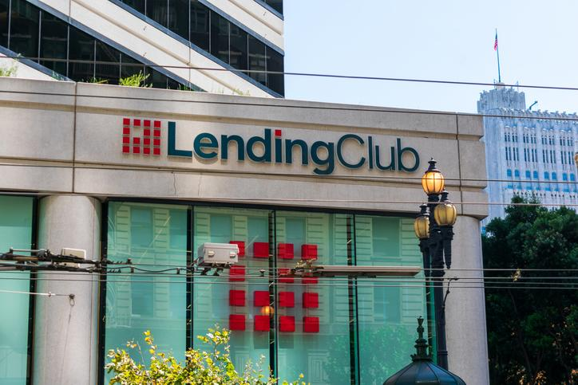
Goal 1
Data Collection:
Selection and Get data

Slide 10
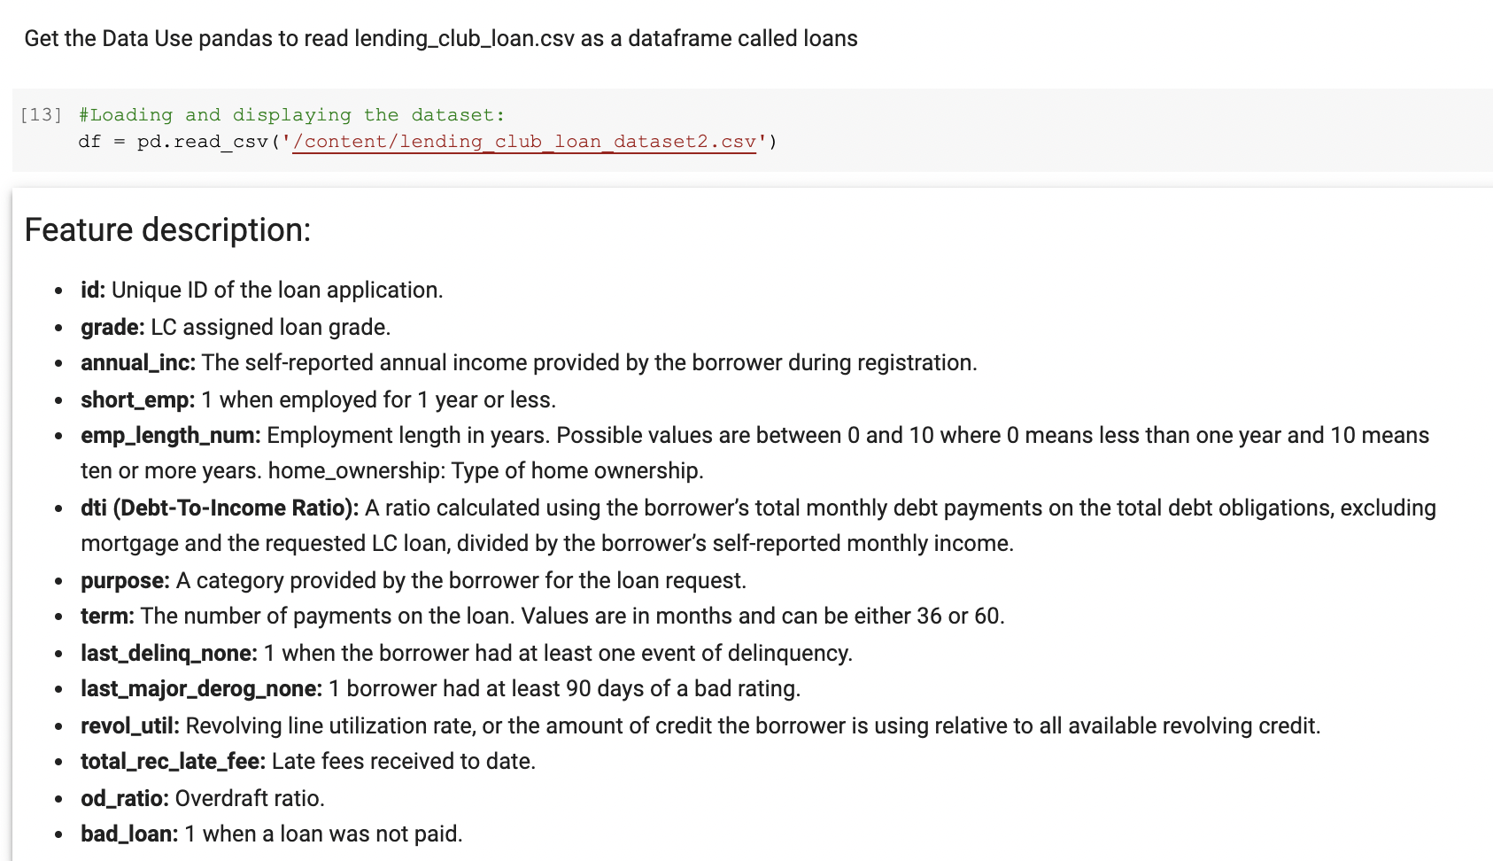
Selection and Get Data

Slide 11
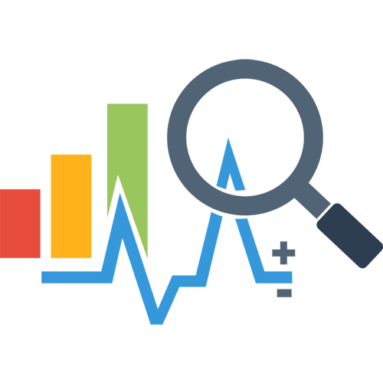
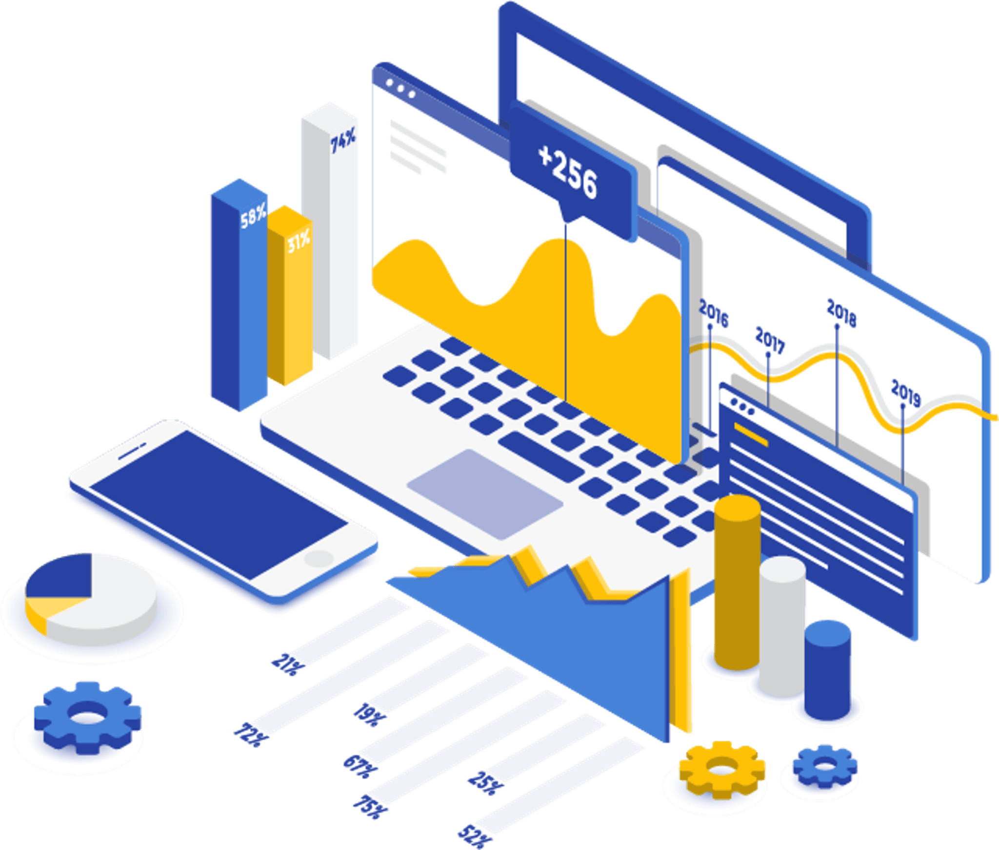
Goal 2
Exploratory Data Analysis (EDA)

Slide 12
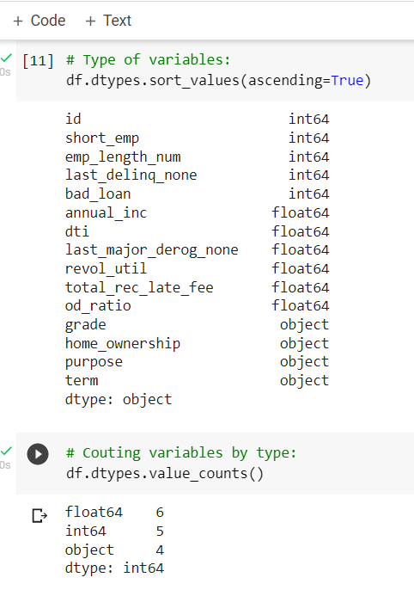
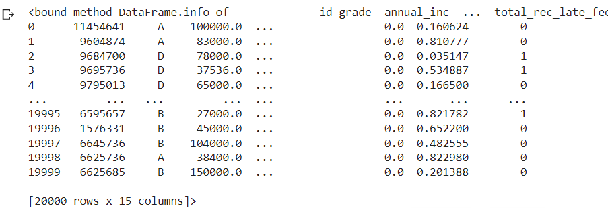
Information

Slide 13
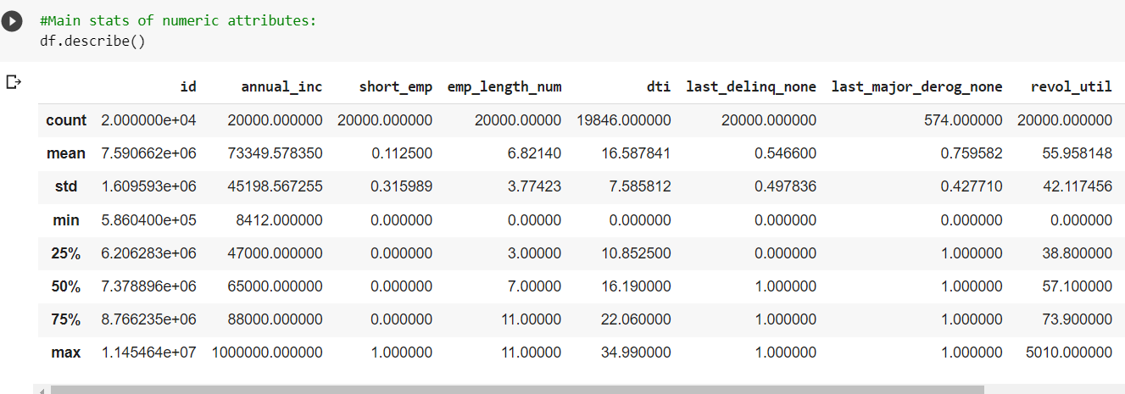
Description

Slide 14
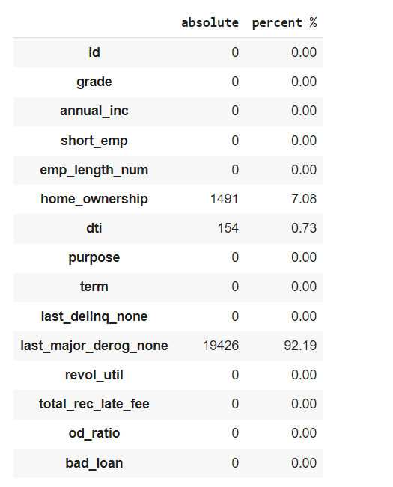
Checking for Missing Values

Slide 15
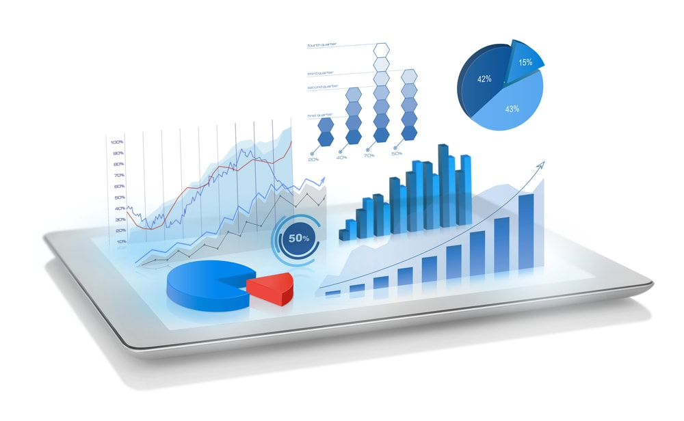

Goal 3
Visualization

Slide 16
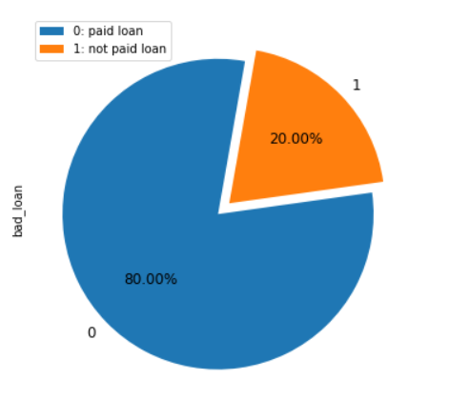
The target variable is: bad_loan 1, (default) not paid 0 paid
Visualization con.

Slide 17
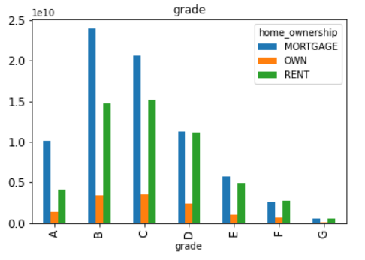
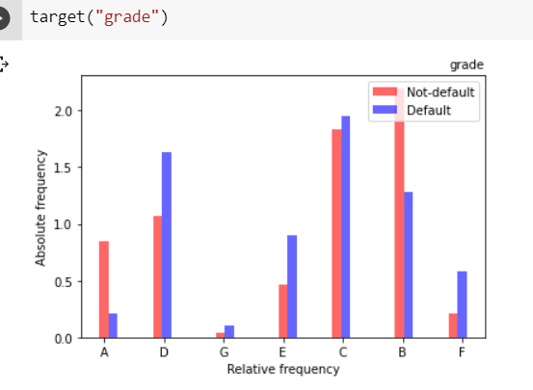
Visualization con.
Feature: grade

Slide 18
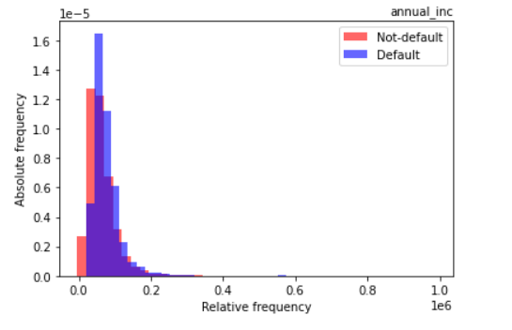
Visualization con.
Feature: annual_inc
The self-reported annual income provided by the borrower during registration.

Slide 19
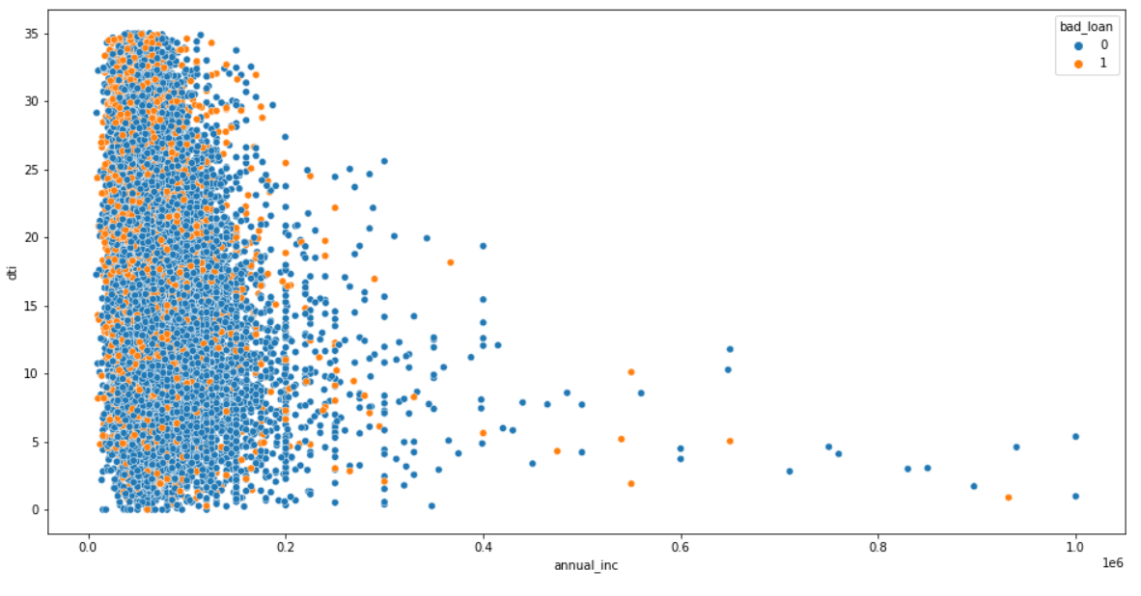
Visualization con.
Display the distribution of ('dti', 'annual_inc', 'bad_loan')

Slide 20
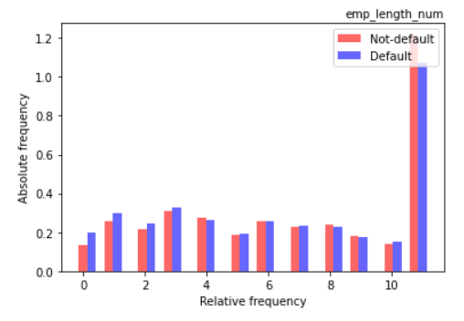
Visualization con.
Feature: emp_length_num
Employment length in years. Possible values are between 0 and 10 where 0 means less than one year and 10 means ten or more years.

Slide 21
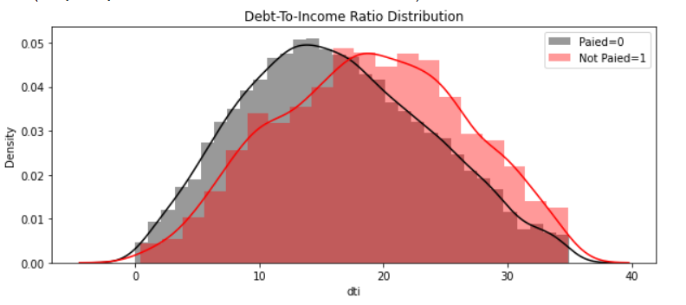
Feature: dti (debt-to-income rate)
A ratio calculated using the borrower’s total monthly debt payments on the total debt obligations divided by the borrower’s self-reported monthly income.
Visualization con.
Notes:
The trend is when the grade classes decrease, the probability of a default loan increases.

Slide 22
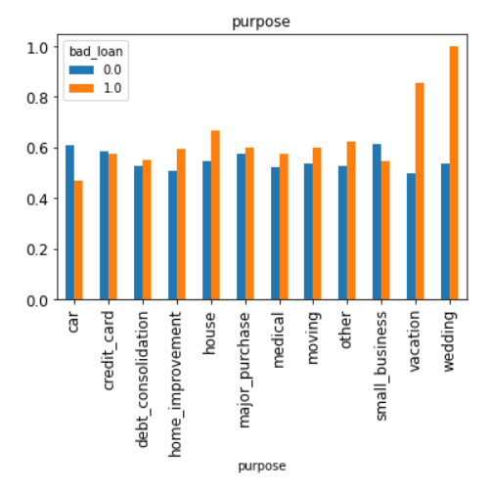
Feature: last_delinq_none
when the borrower had at least one event of delinquency
Visualization con.
Notes:
Loans on default are, on average, the more frequent between loans’ purposes such as vacation and house.

Slide 23
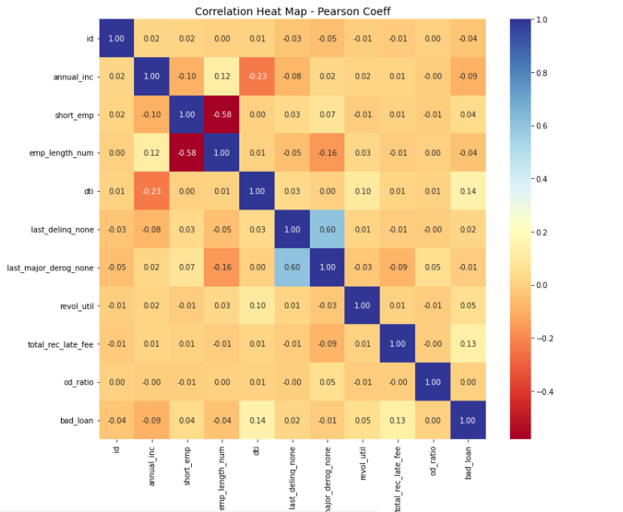
Heatmap
Visualization con.
The heatmap shows there are some positive and negative correlations amongst variables.

Slide 24

Goal 4
Data Wrangling : Cleansing and Feature Selection

Slide 25
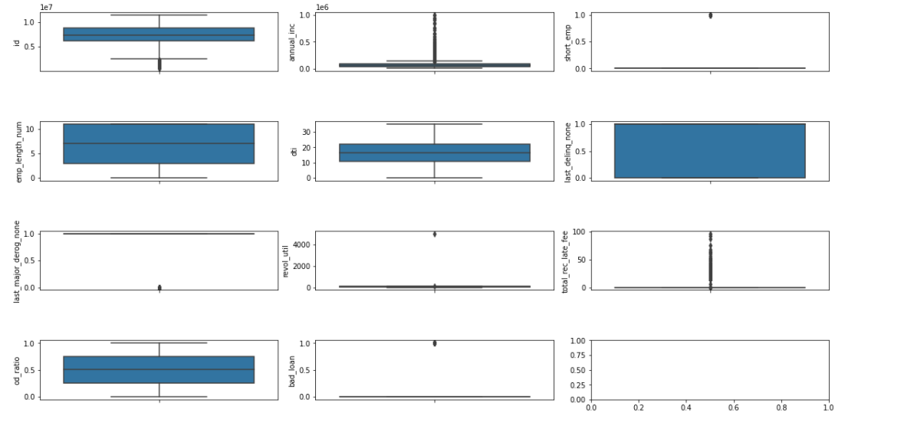
Visualizing the numeric data dispersion
Data Wrangling

Slide 26
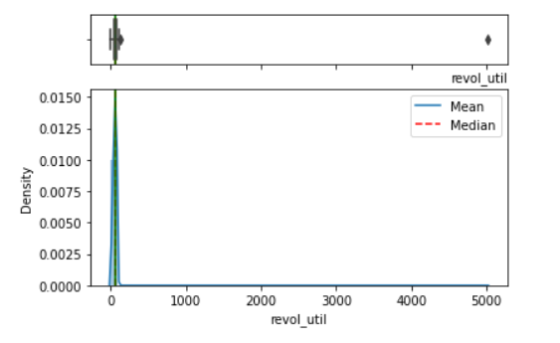
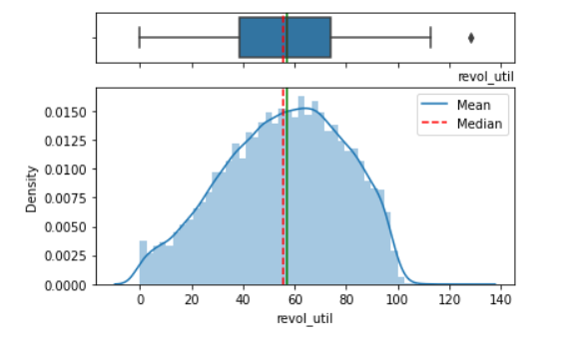
Dealing with outliers:
Data Wrangling con.
There are some outliers in the variables ‘annual_inc’, ‘revol_util’ and ‘total_rec_late_fee’.
for example ‘revol_util’:
Notes:
نحذف الرسمات

Slide 27
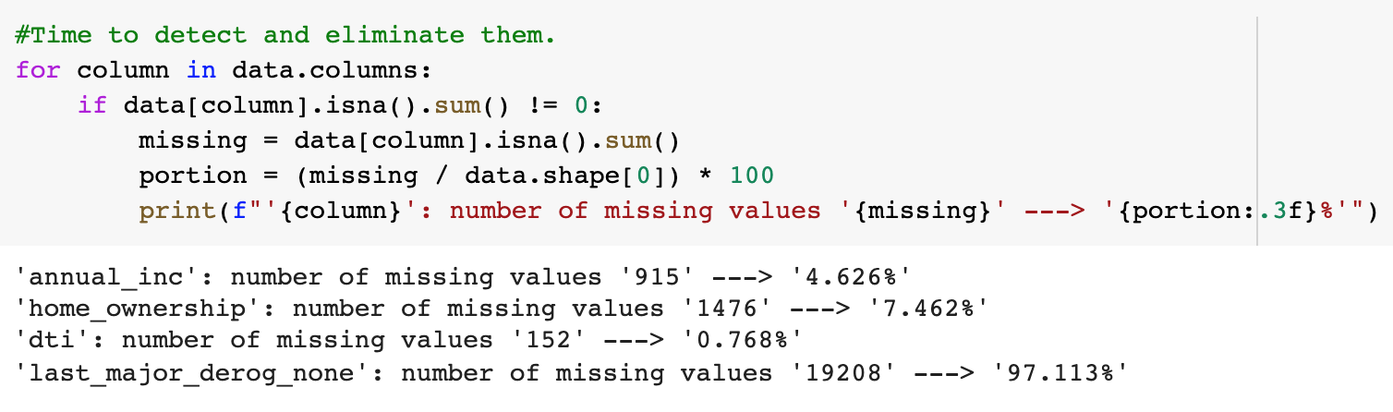
Dealing with missing values
Data Wrangling con.
Notes:
نغير الصور

Slide 28
Data Wrangling con.
Dealing with missing values
Column | Strategy
‘annual_inc’ | Replacing missing values with the mean (average)
‘home_ownership’ | Mode imputation (replacing NaN by most frequent value: Mortage).
‘dti’ | Replacing missing values with the mean (average).
‘last_major_derog_none’ | Drop ‘last_major_derog_none’ numerical variable (too many anomalies).
Notes:
يتغير الترتيب
بالجدول ، بدون كود

Slide 29
Goal 5
Building the Predictive Machine Learning Model

Slide 30
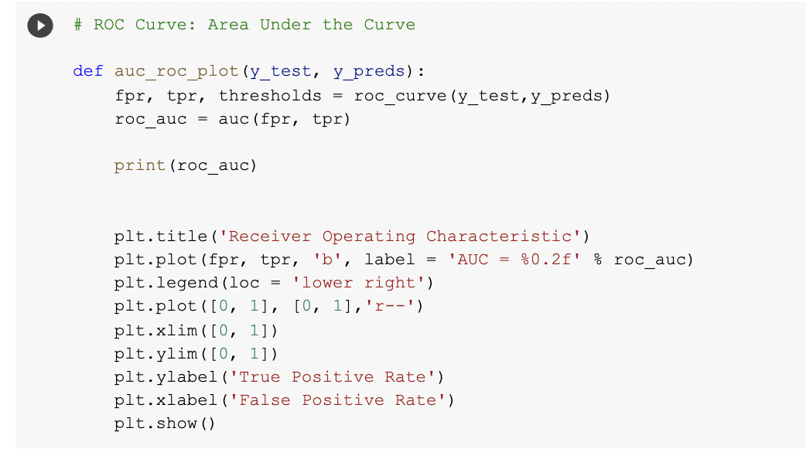
ROC Area under the Curve (AUC)
Building the Predictive ML Model
Notes:
ROC curve
The Receiver Operating Charasteristic(ROC) curve is a common way to assess model performance when the dataset is imbalanced. The area under the ROC curve (AUC) metric is a quantitity that can be used to gauge the performance. Random guess has AUC ~ 0.5 and perfect predictions(which give all correct ranking for labels) has AUC = 1.

Slide 31
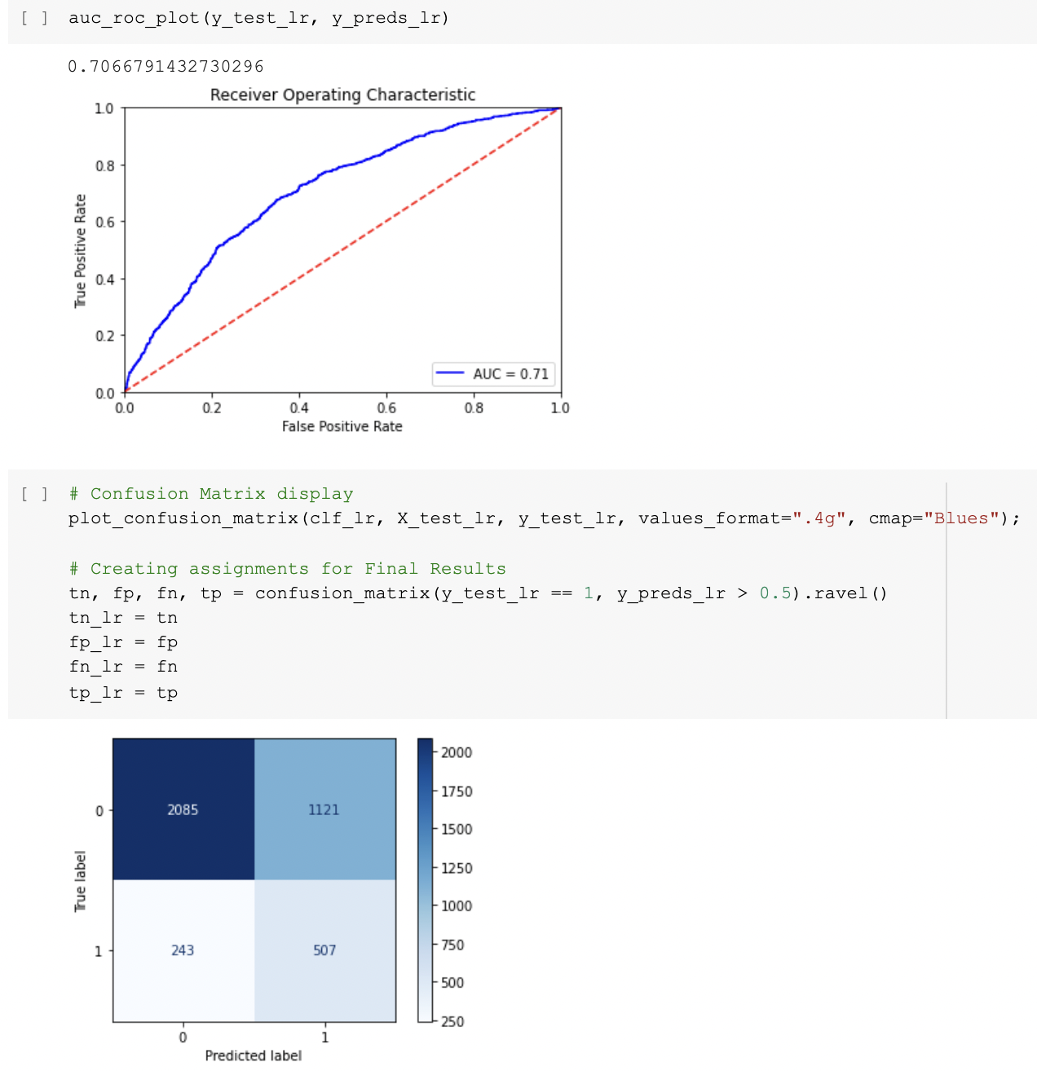
Logistic Regression (LR)
Building the Predictive ML Model con.
Notes:
We chose three models, the first one is Logistic Regression. From the figures presented in the slide, the model fits with 0.7066.

Slide 32
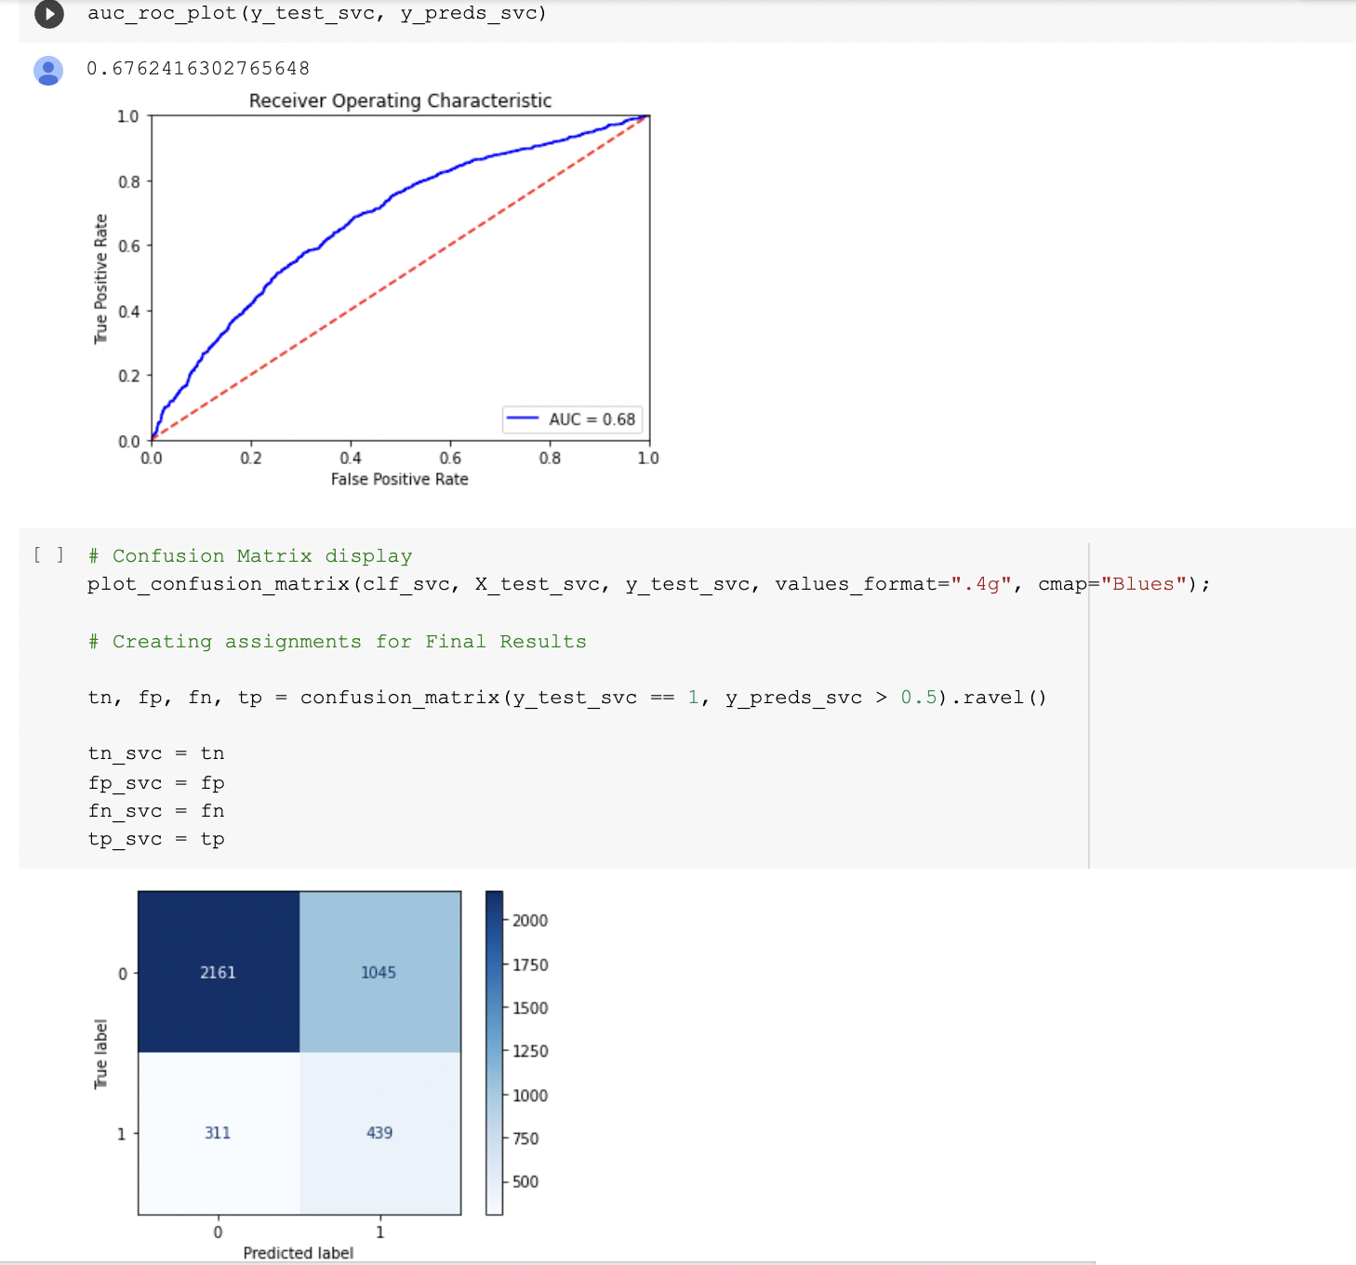
Support Vector Machine (SVM)
Building the Predictive ML Model con.
Notes:
The second one is Support Vector Machine. From the figures presented in the slide, the model fits with 0.6762.

Slide 33
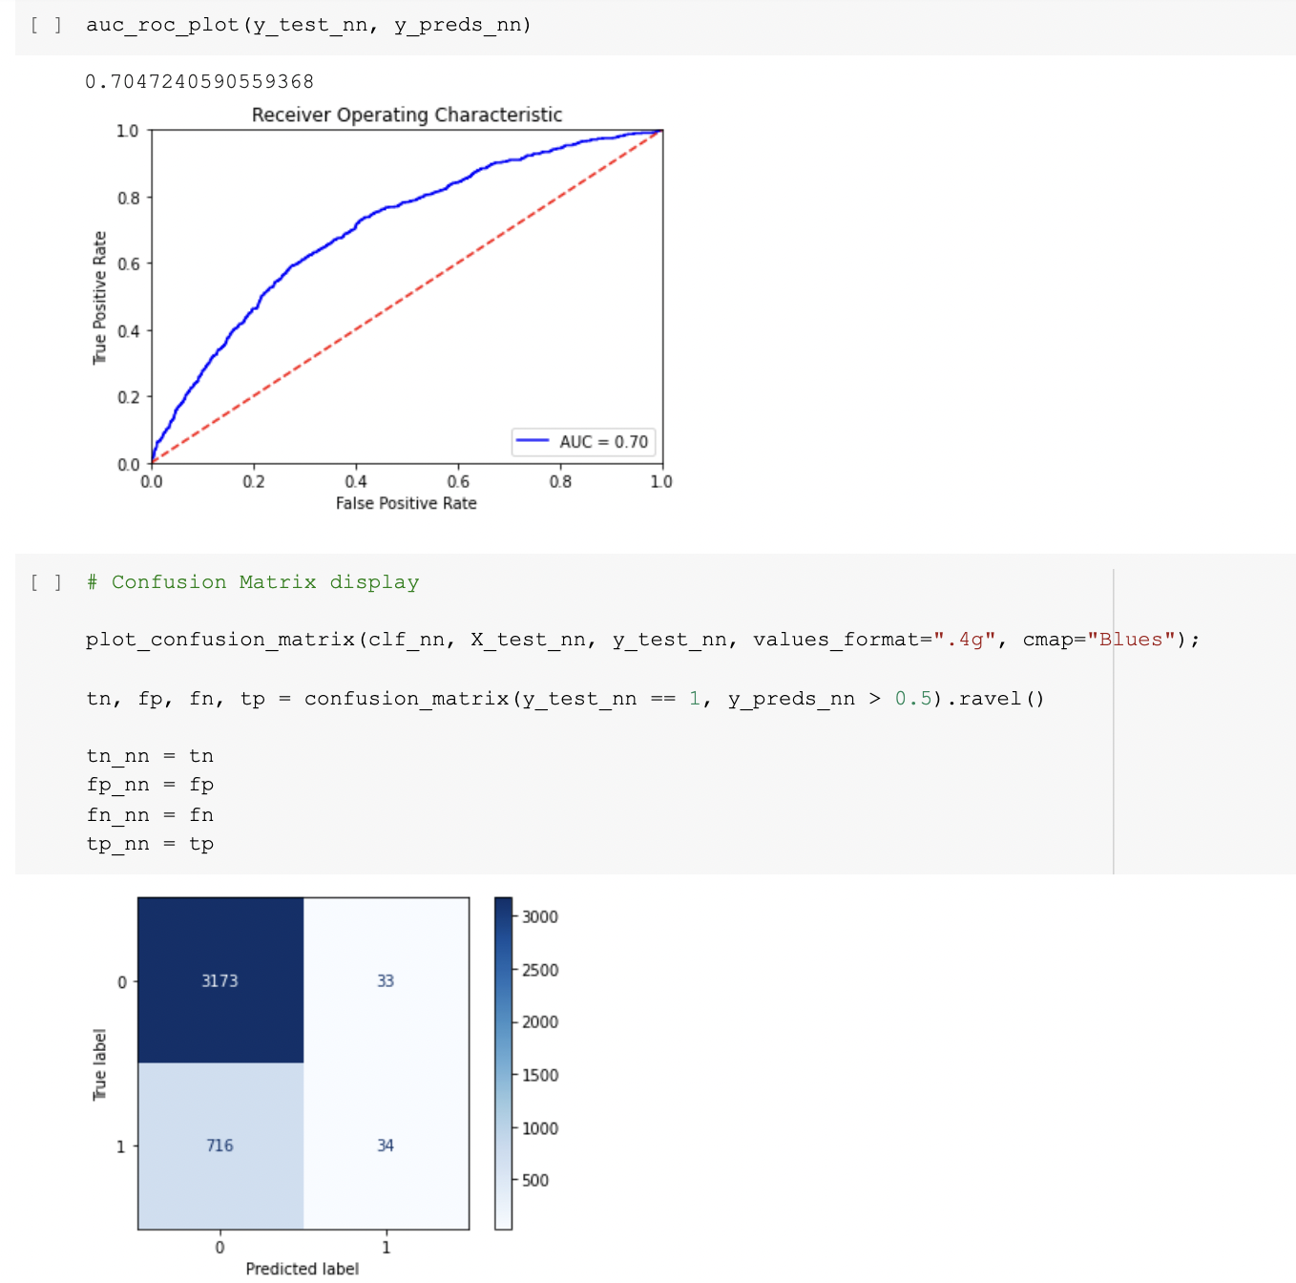
Neural Networks (NN)
Building the Predictive ML Model con.
Notes:
The Third model is Neural Networks. From the figures presented in the slide, the model fits with 0.7047.

Slide 34
Goal 6
Compare between Models and
Select the Right Fit

Slide 35
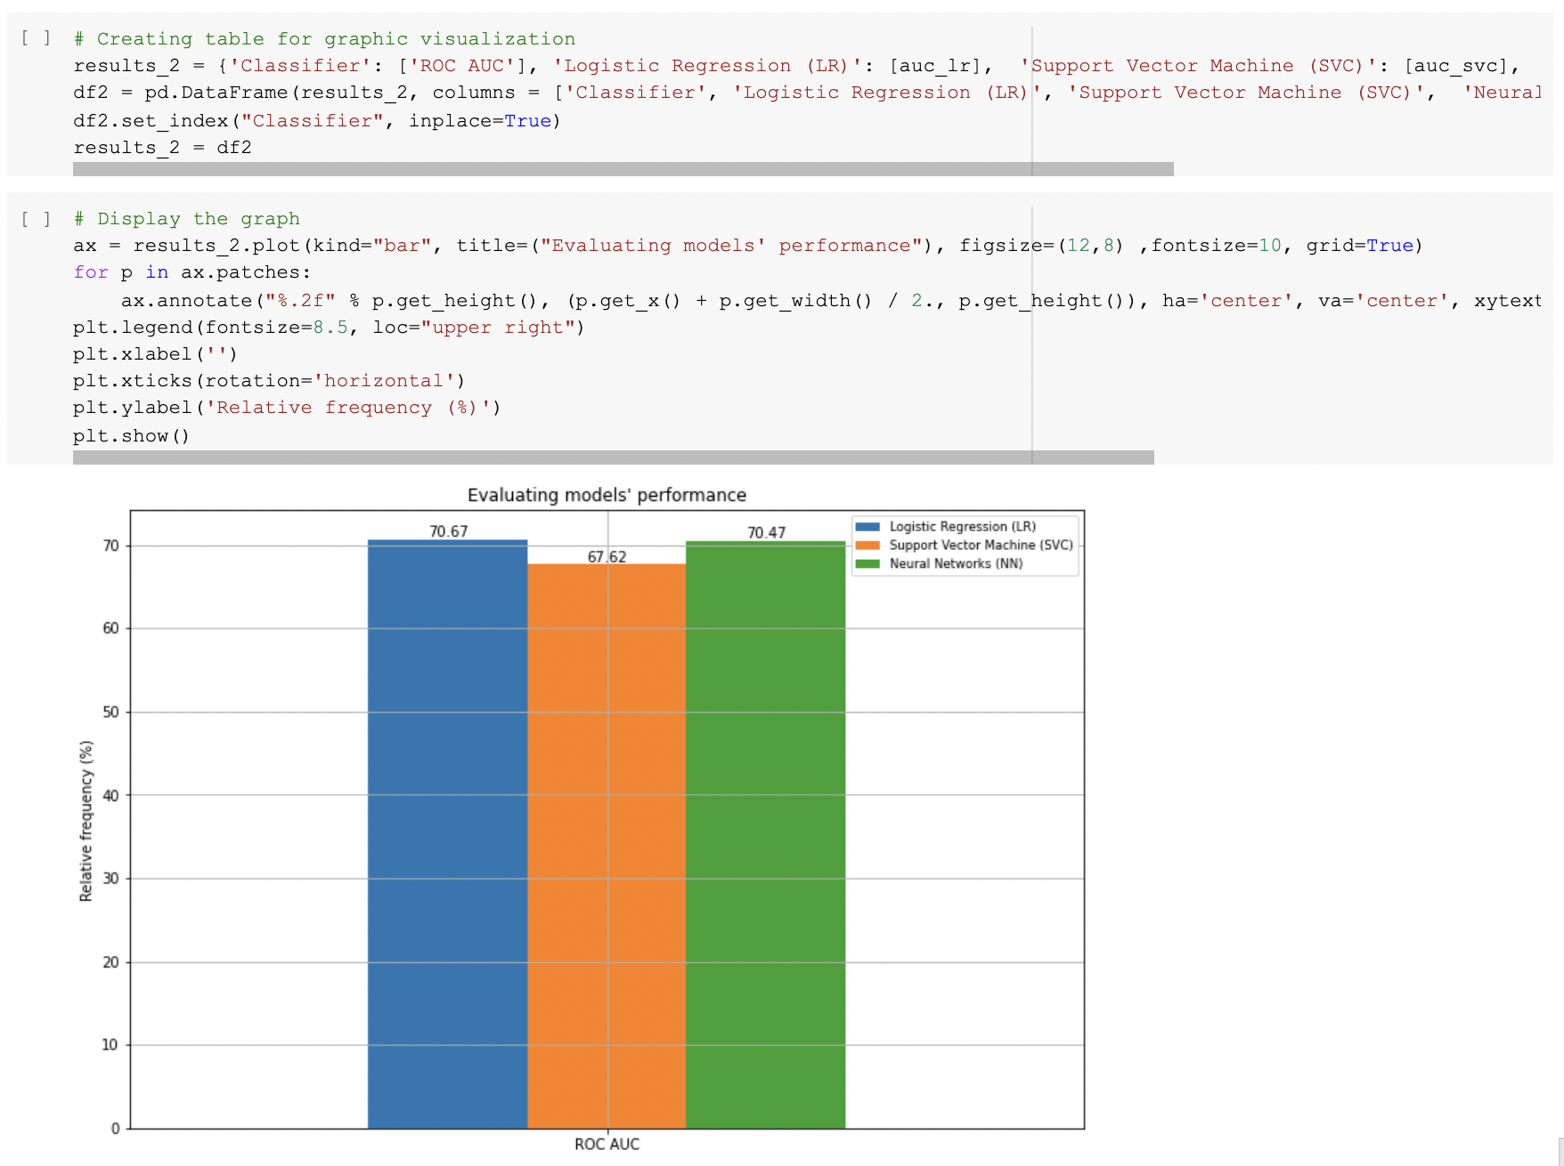
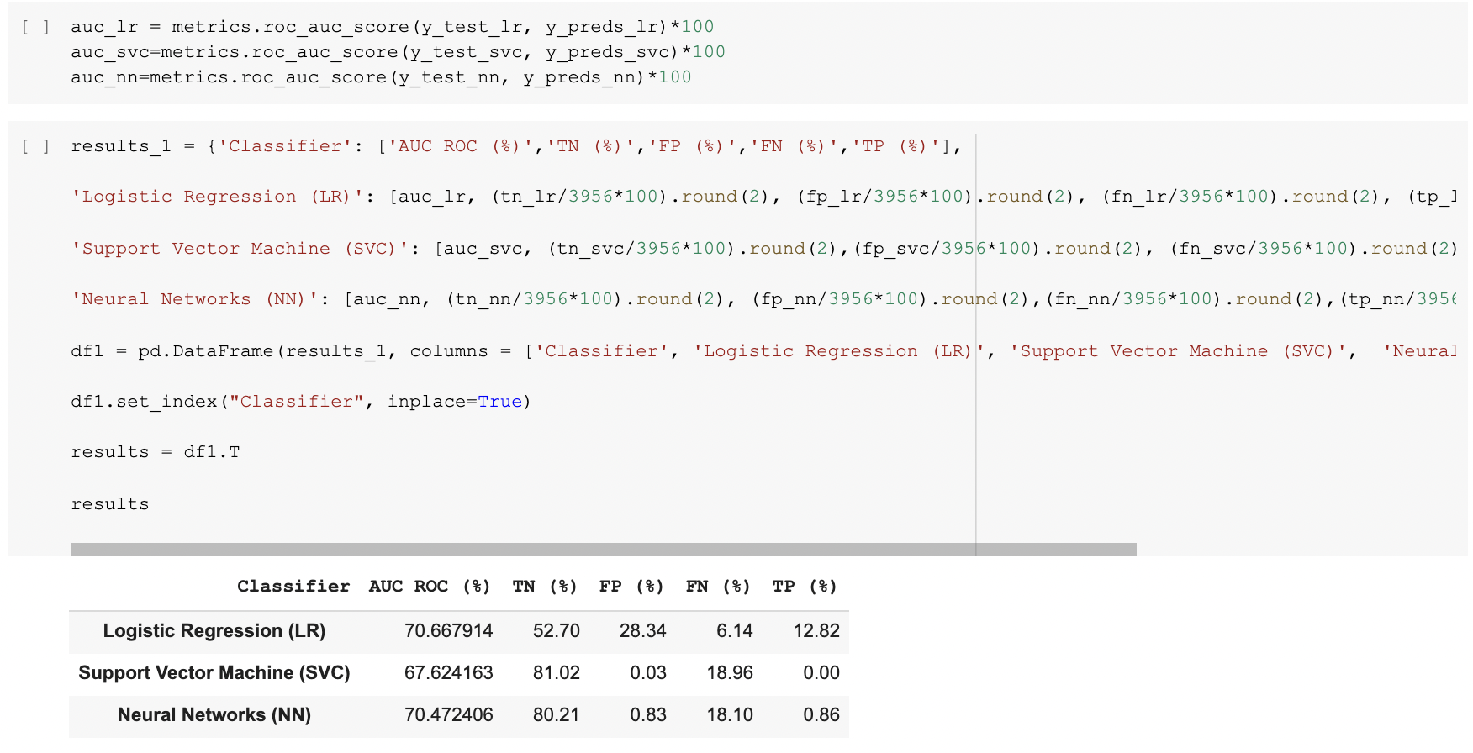
Comparison
Best model:
Logistic Regression - Classifier (LR): 70.67%.
Notes:
According to the table summarize the result Of the evaluate the performance through ROC of the three models. SYI IT
the Logistic Regression Model appears to be the best fit for our dataset ( of the three models) , with 70.67% compare to support vector Machine and neural network
So after we evaluate the performance

Slide 36
Conclusion

Slide 37
Project Limitation
Other machine learning models can be explored to discover the best fit.
The model may be validated using local and Saudi datasets.
Notes:
This project has couples of limitations,
As three models were evaluated, other machine learning models can be explored to discover the best fit.
Additionally, the model may be validated using local and Saudi datasets.

Slide 38
Conclusion
Through using ML Algorithms:
Avoid lending to high-risk consumers and closely monitor loan repayments.
Avoid bad loans by ensuring that loans are issued to borrowers who are likely to repay.
Help to conduct credit analysis of potential borrowers to determine the borrower's credit risk.
Notes:
Individuals around the world depend on the activity of loan lending for reasons such as overcoming their financial constraints in order for them to achieve some personal goals. Similarly, banks, small to large firms depend on the activity of loan lending for the basic purpose of managing their affairs.
Although it is profitable for both the lenders and the borrowers, it carries a loan risk. Throughout the years, machine learning algorithms have been used to calculate and predict credit risk by evaluating an individual’s historical data.
Through using ML Algorithms:
Banks and lending institutions can avoid lending to high-risk consumers, closely monitor loan repayments, and restructure loans when customers get into difficulties.
Bad loans may be avoided by ensuring that loans are issued to only those borrowers who are likely to repay and are unlikely to become bankrupt.
Credit analysis of potential borrowers should be conducted in order to determine the borrower's credit risk and make a loan decision.

Slide 39
Reference
Gupta, A. (2021). Steps to Complete a Machine Learning Project - Analytics Vidhya. Retrieved 5 January 2022, from https://www.analyticsvidhya.com/blog/2021/04/steps-to-complete-a-machine-learning-project/
🏦 Lending Club Loan 💰 Defaulters 🏃‍♂ Prediction. (2021). Retrieved 5 January 2022, from https://www.kaggle.com/faressayah/lending-club-loan-defaulters-prediction
Newest 'python' Questions. Retrieved 6 January 2022, from https://stackoverflow.com/questions/tagged/python
Xu, Z. (2021). Loan Default Prediction for Profit Maximization. Retrieved 5 January 2022, from https://towardsdatascience.com/loan-default-prediction-for-profit-maximization-45fcd461582b
Kolawole, P. (2020). Can you Predict Customer’s Loan Default using Machine Learning?. Retrieved 5 January 2022, from https://medium.datadriveninvestor.com/can-you-predict-customers-loan-default-using-machine-learning-be774489b8f5

Slide 40
THANK YOU!
`
Any Questions?

